Slide 1

SIEBEL CRM IP 2019
NEW FEATURES & RELEASE UPDATES

Slide 2
Purpose
Shows the features and enhancements included in Oracle Siebel CRM Release Updates also new features of Siebel IP 2019 version. Its intended purpose is to help assess the business benefits and for planning the implementation of the new product features.

Slide 3
1
Digital Transformation
2
Customer Experience
3
Innovation
4
Autonomous CRM

Slide 4

Digital Transformation

Slide 5









Disruption in Traditional Industries

Slide 6













Digital Transformation
Safe Harbor Statement
The following is intended to outline our general product direction. It is intended for information purposes only, and may not be incorporated into any contract. It is not a commitment to deliver any material, code, or functionality, and should not be relied upon in making purchasing decisions. The development, release, and timing of any features or functionality described for Oracle’s products remains at the sole discretion of Oracle.
Copyright © 2018, Oracle and/or its affiliates. All rights reserved. |
Speed of disruption increasing
Emergence of pervasive AI
Connected devices going mainstream
CRM CX
Mobility
Social
Unlimited infrastructure to scale
Analytics
Big Data AI
Automation
Explosion of de-centralized big data
AR / VR
Cloud
IoT Edge
Blockchain

Slide 7



Oracle Drives Digital Transformation
Industry Solutions
Connected Experience
Marketing
Commerce
Sales
Service
Artificial Intelligence
IoT Analytics
Behavioral Analytics
Marketplace
Connected Intelligence
Connected Data
Master
Transactional
Operational
Sensor
Behavioral
External
Siebel CRM
Platform
Oracle Cloud Blockchain

Slide 8
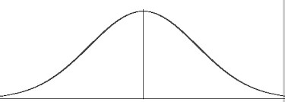
Siebel Strategy
Path to Digital Transformation
2013-15
2016
2017
2018
2019
2020
2021
2022
NO
2023 END DATE
Applications Unlimited
Digital: User
Digital: Developer, Administrator
User (Mobile)
Intelligent
Mesh

Slide 9


Customer Experience

Slide 10

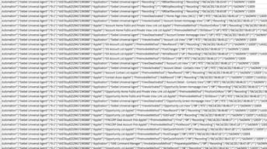

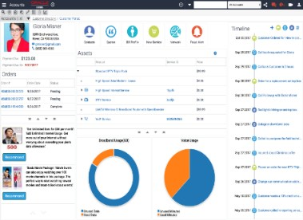


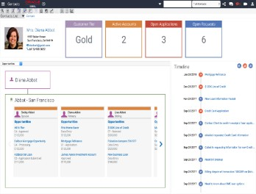
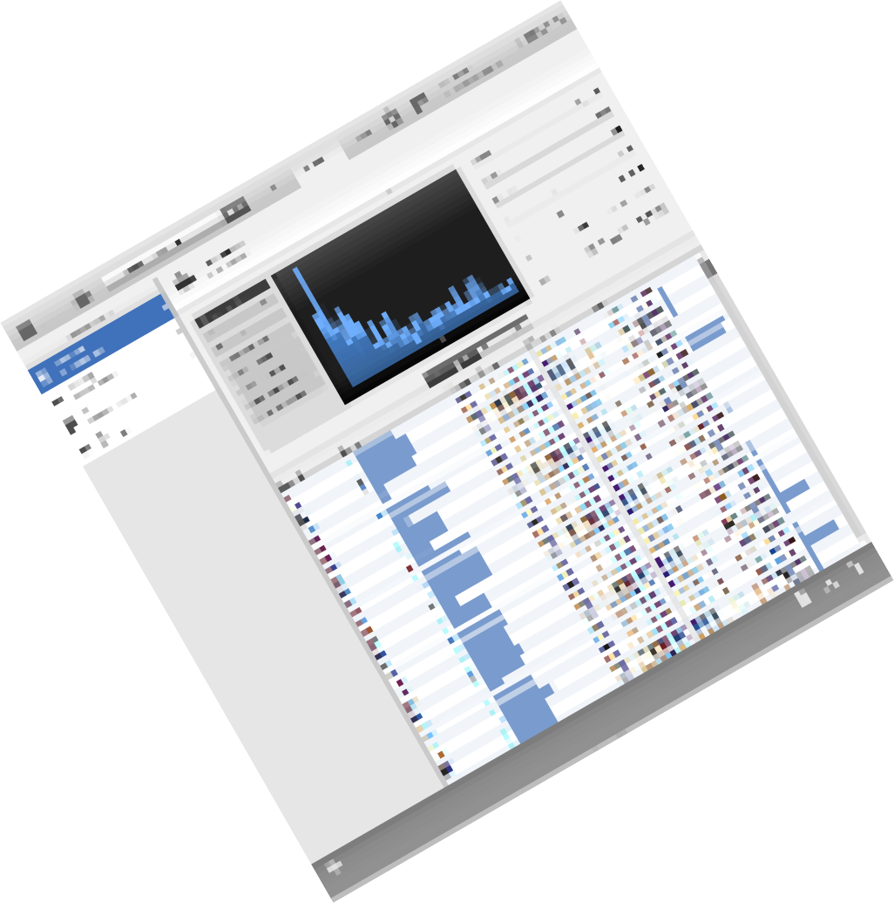

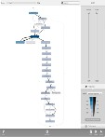
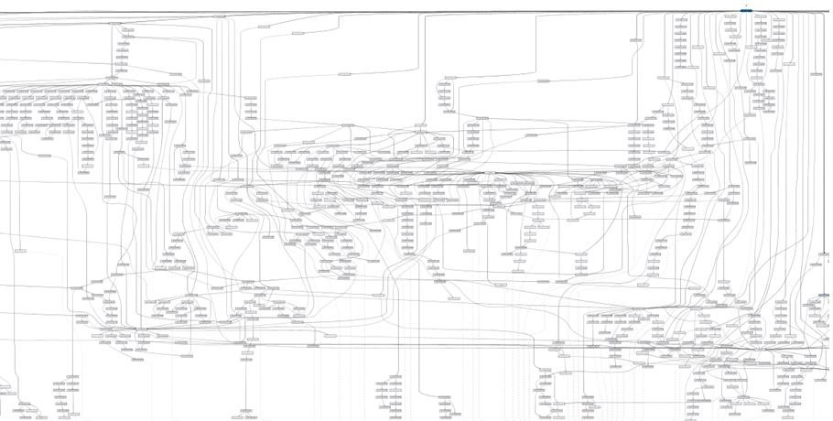
Users: Insights
Data-driven visualization & tasks
Prebuilt charts
Predefined dashboards
Responsive across devices
Chatbots, Voice recognition
Guided user journeys
Usage-based workflow identification
Path to automated tasks

Slide 11

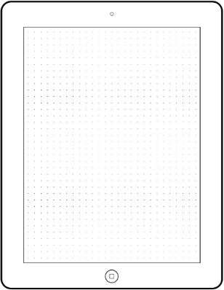
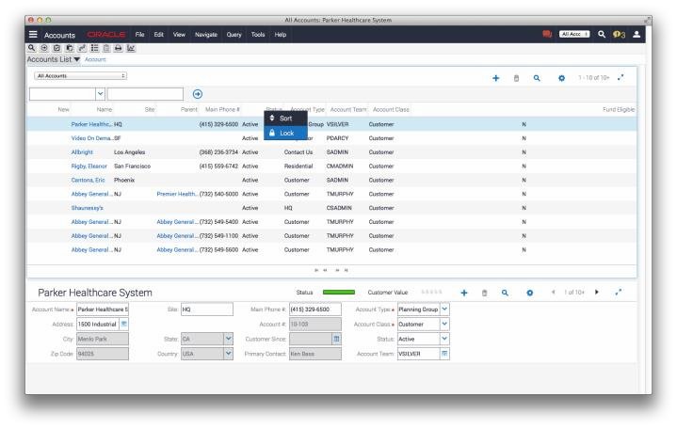
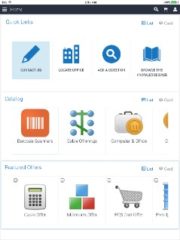
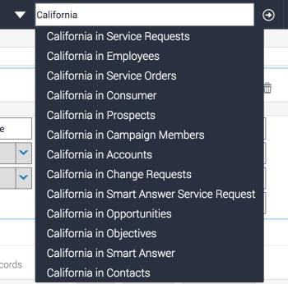
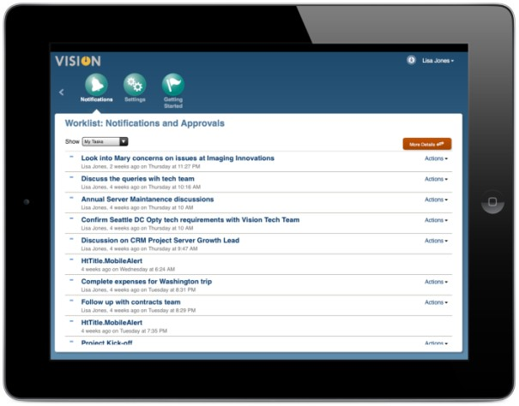


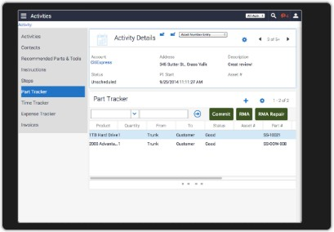
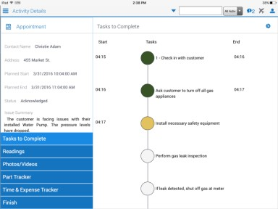
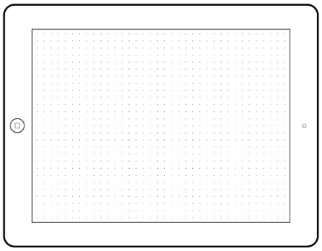
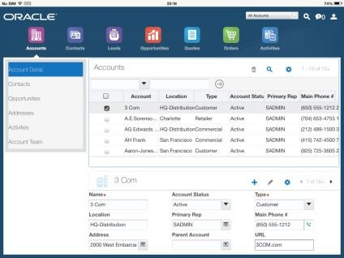
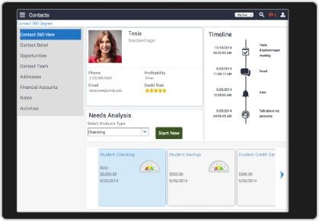
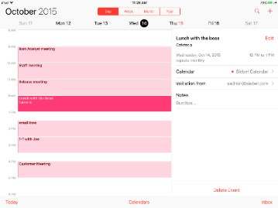
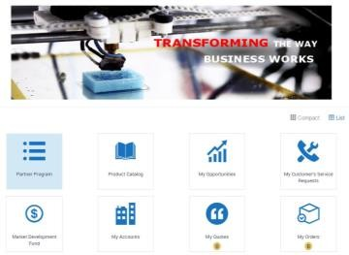
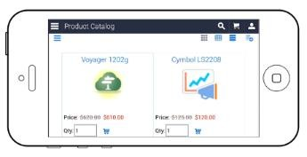
Usability
Customer Experience
Open UI
Mobility
Portals
Continuous improvements and features added to Open UI
Full RWD, elastic list applets, themes, intuitive Search, Outlook, chat integration & Inbuilt Elasticsearch.
Fully extendable, improved performance helping customers deliver innovative solutions to the modern consumer
Mobile apps with seem-less offline
support
Integrated apps for the mobile customer based on their needs using calendar, timeline, barcodes
Purpose built apps for Field Services ,Life Sciences, Consumer Goods & Financial…
New Open UI portals allowing customers to deliver innovative user interactions for their connected customers
Partner portal based on user interactions when and where they need them – eSales, eCustomer and Self-Service

Slide 12
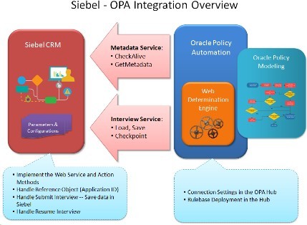

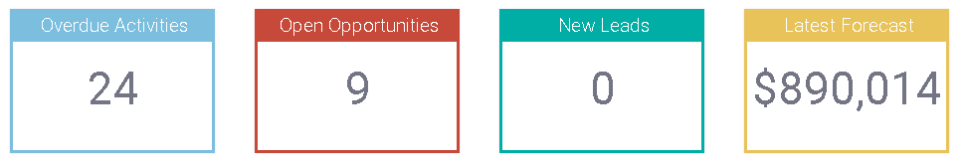

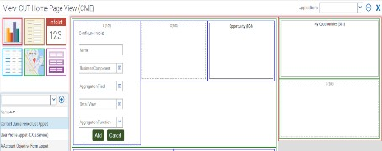
Developers: Automation
Contextual metadata generation
Dynamic metadata alignment
Easy development, customization and deployment
Context-Sensitive Defaults

Slide 13


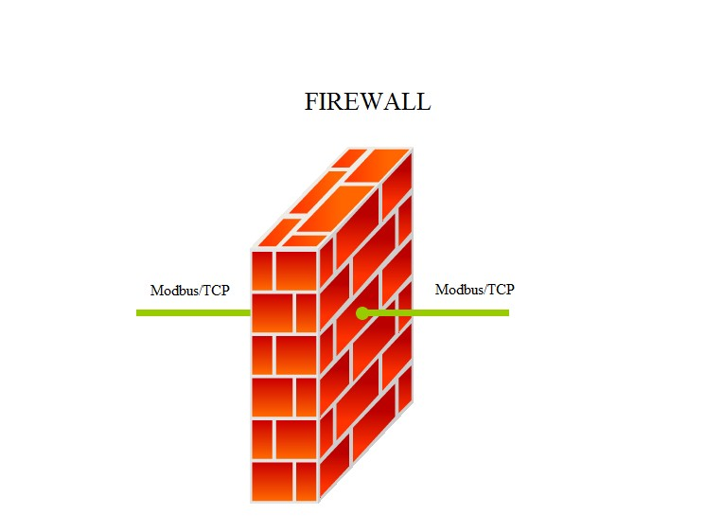

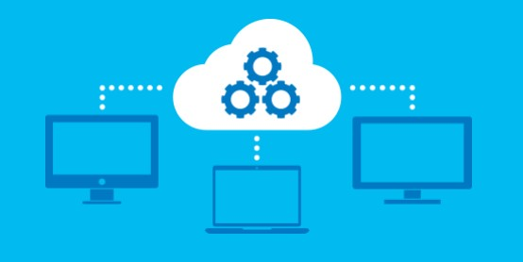





Administrators: Automated Secure Deployment
Migration – Synchronous or Asynchronous
Development
Production
Development
Production
Migration
Siebel 2019
Eliminates dependencies on Source and Target
Organizations have Governance for accepting
migration packages from SI/Vendors
IP-2017
Source and Target servers available/connected
Discovery is dependent on the source/target availability

Slide 14
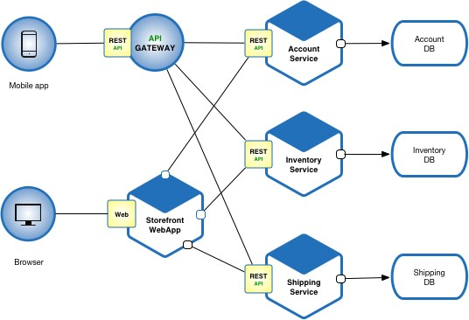
Architects: Elastic deployment
Microservices : Distributing apps, repositories, databases
Today
M apps
1 runtime repository
1 database
AI embedded apps
Future
M apps
N repositories
J Databases
AI/ML embedded apps
16

Slide 15



Innovation
Copyright © 2018, Oracle and/or its affiliates. All rights reserved. |

Slide 16

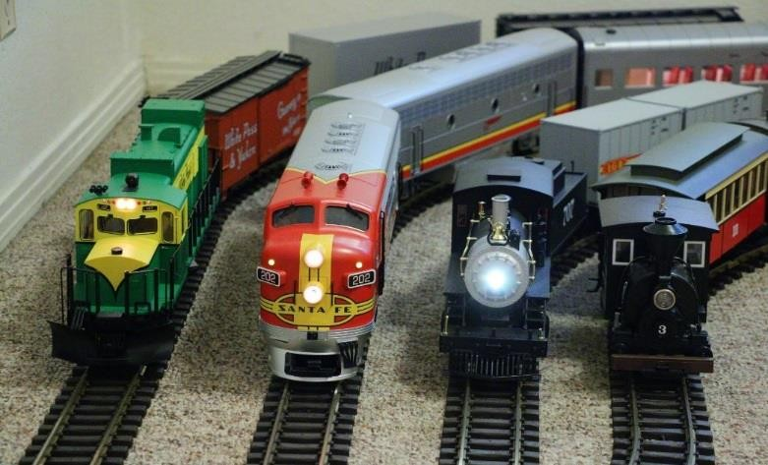

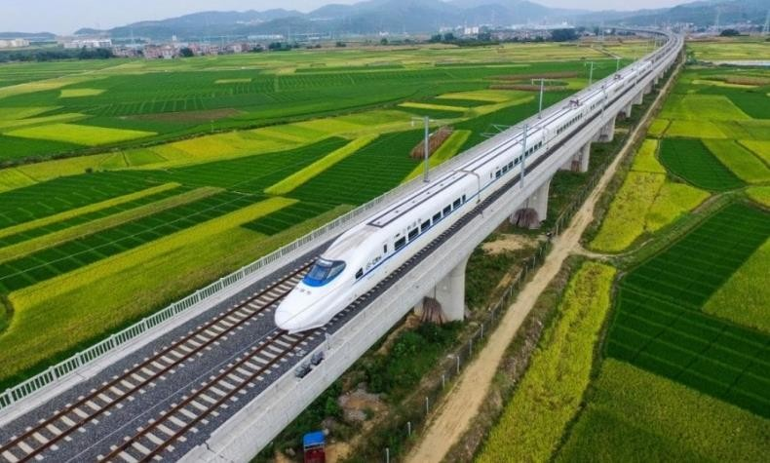

Continuous Delivery: Serial Updates
No upgrades: less disruption, faster adoption monthly only patch updates from Siebel IP 2018
Multiple parallel codelines
Numbering is [IP Year].[1-19]
Single cumulative codeline
Numbering is Year.Month

Slide 17








Siebel Roadmap – Continuous Innovation & Delivery
2013-15 2016 2017 2018 2019 2020 2021
Applications Unlimited
2022
2023
NO END DATE
UX & UI
Partner,
Customer Apps Usage Pattern Tracking
DevOps Monthly Updates Docker Containers Gateway Clusters
Big Data/AI
Auto-charting
Task prescription Cross-industry IoT
Decentralization Distributed Siebel data, computing, orchestration
UX & UI
Autonomous
CX
Agile Upgrades &
Development,
Open UI & RWD,
Mobility
RESTful APIs
DevOps
DevOps/AI* Mobile-app generation Chatbots, Voice, NLP
Data Visualization
Distributed AI-ML
Blockchain, …
Cloud-Ready
Big Data/AI
Edge intelligence Federated data and tasks
Zero downtime Auto Test Automation
*0-12 months
Digital: User
Digital: Developer, Administrator
User (Mobile)
Intelligent
Mesh

Slide 18

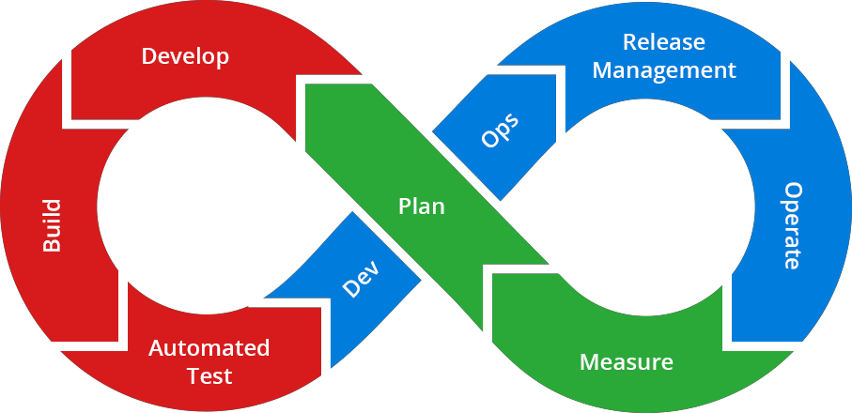





Near-Zero Downtime
Continuous Innovation & Delivery (CI-CD), Industry Standards
Simplified Dev-2-Prod & Dev-2-Test via browser- based application
Siebel Approval Manager
Parallel Development
Siebel Composer
Outbound REST, Open API
CHEF on Oracle Cloud (IP16 internal) Siebel Instance in < 1 hr
Roadmap & Statement of Direction (SOD)
Dynamic Gateway
Unified User, REST &
SOAP interface
High-availability scale up/down, dynamic enterprise registry
Based on CAB
input
Docker Containers
Jenkins DevOps pipeline
Enterprise Manager
Usage-Pattern Tracking
Built-in Test Automation
Siebel Test Execution Jenkins Plugin

Slide 19



Innovation Highlights
Innovations across personas
Users
Developers
Administrators
Sky Blue Theme
Multitasking
Mobile UI Enhancements
Live Experience Integration
Applet/View Layout Editor
Task Editor
Script Editor/Debugger
Workflow Preview
SMC Administration
Workspace Rollback to Last Good Version
Asynchronous Migration

Slide 20











Flight Path to Digital Transformation
1. Private Cloud (On Premise)
2. Platform (IaaS/Paas)
3. Hybrid CX (SaaS)
Siebel on-Premise
Open UI UX & Mobility
Continuous innovation &
delivery for business agility
Process Automation -> Autonomous CX
Siebel on Cloud
Oracle Cloud Infrastructure
Migration Tooling
Managed Services (OMCS)
@Customer, Cloud Machine
Siebel + CX applications + Adaptive Intelligence
Hub-and-spoke Integration
Cloud Services (ICS)
Customer 2 Cloud option (unused licenses)

Slide 21
Lifetime Support for Existing Oracle Applications*
Enabling customers to confidently maximize and/or expand their existing Oracle application investments with ample time for future planning by providing assurance in Oracle’s commitment to support its existing applications via a stable and predictable long term support policy.
Premier Support “through at least” 2040
Rolling 10 years of Premier Support
Now
FuturFeuturFeuturFeuturFeuturFeuturFeuturFeuturFeuturFeuturFeuturFeuturFeuture
Premier Support
2020 2025 2030 … 20XX
At Least a Decade of Oracle Premier Support
2015

Slide 22


















Siebel Focus: Scalable, sophisticated CRM
180,000
170,000
160,000
140,000
Leading Global Customers
120,000
98,000
100,000*
100,000
80,000
60,000
50,000
54,000
40,000
Multiple Industries
40,000
29,000
30,000
32,000
24,000
25,000
25,000
25,000
20,000
0
* Projected
26

Slide 23

AUTONOMOUS CRM
The automation imperative continues to require CRM systems to focus on superior customer experience. From the manual digital phase (self-service, mobile) to the increasingly data intensive and automated (Social, IoT), we are being driven to position Siebel CRM on the combination of usage data with pre-built processes. The automation of processes is now manifest in the long-term roadmap for Siebel CRM.
Multiple use cases from the availability of structured process data:
Business Process Discovery
Analyzing process data for process mining
Creating user training content
Producing iHelp content
Generating tasks for the Task Based UI
Constructing task-based flows and automatically creating microservices from recorded processes
Business Process Automation
33

Slide 24
END

